Slide 1


































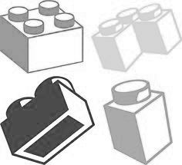
Our Geography
Journey
Where does our energy come from?
Mapping skills
Secondary education
Can I carry out an independent fieldwork enquiry?
Why does population change?
YEAR
6
Why do oceans matter?
Would you like to live in the desert?
YEAR
Developing a geographical enquiry
5
Using maps
What is life like in the Alps?
Developing a geographical enquiry
Where does food come from?
What are rivers and how are they used?
YEAR
4
Why are rainforests important to us?
Maps of the world – longitude and latitude
Are all settlements the same?
YEAR
3
Developing a geographical enquiry
Why do people live near volcanoes?
Who lives in Antarctica?
What is it like to live by the coast?
7 Continents 5 Oceans
Why is our world wonderful?
Developing a geographical enquiry
YEAR
2
Would you prefer to live in a hot or cold place?
What is it like here?
What is it like to live in Shanghai?
Local area map work
What is the weather like here?
Developing a geographical enquiry
YEAR
1
Our Learning Journey
Where is Birkdale?
Where do I live?
C
EYFS
Making simple maps
Develop a lifelong love of learning
Build a solid foundation in education
Our curriculum is structured differently, we explain things geographically, we model uniquely geographical things and we ask questions as geographers

