Slide 1
Managing Children with Severe Allergies in Schools

Slide 2
Allergic Symptoms
Can be mild
For example from skin contact or minimal ingestion and may include
Hives/itchy skin
Itchy eyes
Eye Swelling
Runny Nose/sneezing
Lip Swelling
Tingling sensation of lips/tongue
Child not too distressed

Slide 3
Allergic Symptoms
Can be severe and may include
Severe swelling of mouth
Severe tongue swelling (“fat tongue”)
Complaining of throat closing over
Coughing and wheezing
Sense of “impending doom”
Difficulty in breathing
Collapse
Anaphylaxis

Slide 4
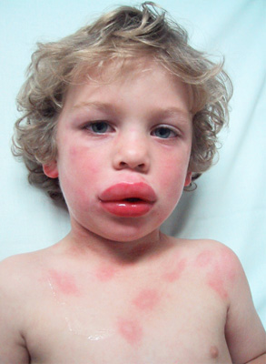
Severe Allergic Reaction
Picture courtesy of Anaphylaxis Campaign

Slide 5
What is Anaphylaxis
Anaphylaxis is a severe systemic allergic reaction
At the extreme end of the allergic spectrum
The whole body is affected usually within minutes of exposure to the allergen
It can take seconds or several hours

Slide 6
Definition of Anaphylaxis
Anaphylaxis involves one or both of two features:-
Respiratory Difficulty – Swelling of the airway or asthma
Hypotension – Fainting, collapse or unconsciousness

Slide 7
Common Causes
Peanuts
Tree Nuts
Milk
Egg
Sesame
Fish
Shell Fish
Venom (Wasp or Bee)
Kiwi
Latex

Slide 8
Treatments
Adrenaline is the mainstay of treatment
Reverses swelling
Relieves Asthma
Constricts blood vessels
Stimulates heartbeats
Antihistamines and reliever (blue) asthma inhalers

Slide 9

Adrenaline Auto Injector (AAI) Devices
Epipen
Epipen Junior 0.15 mg strength children 15-25 kgs
Epipen 0.3 mgs strength for children >25 kgs

Slide 10

Adrenaline Auto Injector (AAI) Devices
JEXT
Jext Junior 0.15 mg strength children 15-30 kgs
Jext 0.3 mgs strength for children >30kgs

Slide 11

Adrenaline Auto Injector (AAI) Devices
EMMERADE
0.15 mgs (15-30 kgs)
0.3 mgs (>30 kgs)
0.5 mgs (adolescents and adults depending on body wt.)

Slide 12


Emergency Kit
Oral Antihistamine
Management Plan
Possibly an Adrenaline Pen
*Volumatic
*Bronchodilator
* Only if child is asthmatic

Slide 13
Storage of Emergency Kit
Easily Accessible – not locked away
Avoid Extremes of temperature
Clearly labelled
In date medications

Slide 14
How to Manage a Mild Allergic Reaction
Follow the Allergy Action Plan
Accidental Ingestion – SPIT IT OUT straight away
IF THERE IS
Rash/swollen eyes
Tingling/burning sensation on lips
BUT the child is not distressed
Give oral antihistamine
Contact parents
Observe child

Slide 15
How to manage a severe allergic reaction
If there is
Severe swelling of lips/tongue/mouth
Difficulty in swallowing
Difficulty in breathing or if the child collapses
Give Adrenaline Auto Injector immediately into upper and outer thigh
Call 999. Say that child has had ANAPHYLAXIS (ana-fil-ak-sis)
If child asthmatic and is coughing & wheezing, give 1 puff of their BLUE inhaler every 30 seconds up to 10 puffs, & then 1 puff every minute until help arrives.
Remember to shake the canister in between each puff)
If child faints or collapses, lay in recovery position, they should remain lying down until ambulance arrives
      Call parents

Slide 16
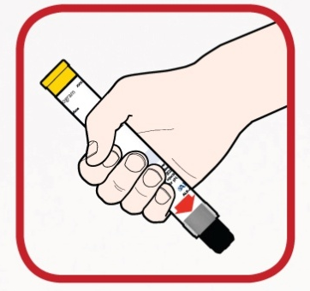
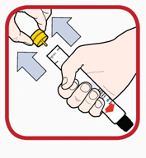
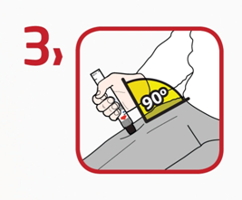

How to use JEXT
1. Form a fist around JEXT and pull off the yellow cap
2. Point the black end towards outer mid-thigh
3. Push hard into thigh until a click is heard and hold for 10 seconds
4. Remove JEXT and massage the leg for 10 seconds

Slide 17
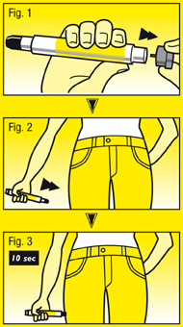
How to use an Epipen
Grasp EpiPen® in dominant hand, with thumb closest to grey safety cap
With other hand, pull off grey safety cap (Fig. 1)
Hold EpiPen® approx. 10cm away from outer thigh
Black tip should point towards outer thigh (Fig. 2)
Swing & jab firmly into outer thigh, through clothing if necessary
Hold in place for 10 seconds (Fig. 3)
Regularly practice emergency administration with an AAI training device

Slide 18


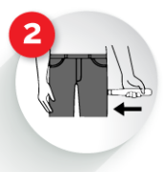
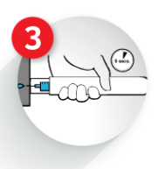
How to use an Emerade AAI
Press against outer thigh
Hold for 5 seconds, then massage site

Slide 19
How Can the School Help
The School
Identify a core team of (but not limited to) head teacher, school nurse, form teacher, year head, first aider/s and school cook/catering staff who are ‘willing’ to work with parents and the pupil to establish a food allergy action plan.
Discuss “allowed” foods with the parents and child
Consider allowing the pupil to carry an oral anti histamine at all times*
Consider allowing the secondary school age pupil to carry their adrenaline pen on them*
Include food-allergic students in school activities
*Age appropriate

Slide 20
How Can the Family Help
Educate the child in the self-management of their food allergy including:
Safe and unsafe foods
Strategies for avoiding exposure to unsafe foods
Symptoms of allergic reactions
When to tell an adult they may be having an allergy-related problem
How to read food labels (age-appropriate)
Always ensure medications are available and in date
Always keep the school informed of changes to allergy management plan or development of new allergies
Always ensure up to date contact details are available

Slide 21
How Can the Student Help
  Should not trade food with others
  Should not eat anything with unknown ingredients or known to contain any allergens
  Should be proactive in the care and management of their food allergies and reactions based on their developmental level
  Should notify an adult immediately if they eat something they believe may contain the food to which they are allergic
  Inform friends what to do if an allergic reaction occurs (i.e. get help from an adult, dialing for help, location of emergency kit.

Slide 22
A few things to think about
Supply teachers need to be made aware too
Breakfast/After school clubs
Hot dinners v Packed lunches
School day trips, PGL, prize giving evenings etc.
Cooking classes/world food day
Science experiments/model making with used cereal boxes etc.
Special occasions, party bags, treat boxes
Cake Sales

Slide 23

New legislation comes into effect from Oct 1st, allows ‘spare’ emergency adrenaline auto injectors (AAI’s) in schools.
Govt. amended Human Med. Act to allow schools to buy AAI’s from pharmaceutical supplier without prescription, for use in emergencies.
Allows schools to administer an emergency AAI to any child who has been assessed as being at risk of anaphylaxis.
Not compulsory
Is likely to increase need for training for school staff
AC developing a web site to provide online resources for school staff

Slide 24
For Further Information
Training videos and support can be found at
www.allergynorthwest.nhs.uk
www.jext.co.uk
www.anaphylaxis.org.uk
www.emerade-bausch.co.uk

