Slide 1
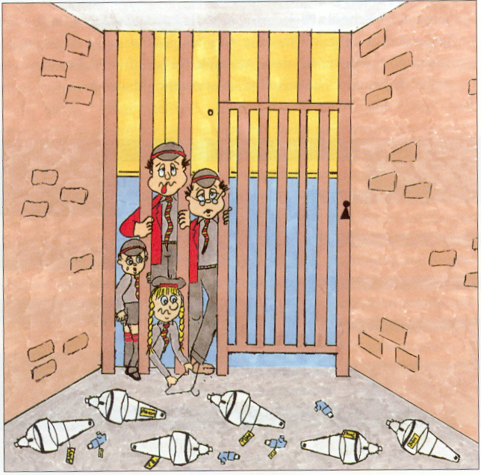
Asthma in School

Slide 2
Asthma the Facts
                The UK has among the highest prevalence rates of asthma in children worldwide.
The UK has among the highest prevalence rates of asthma
in children worldwide.
1 in 11 children in the UK have asthma¹
On average, 2 children in every school class have asthma¹
25,073 emergency hospital admissions for children in the UK
On average there were 69 admissions per day or one every 21 minutes.
£1 billion, 1% of the total NHS budget is spent on asthma¹
Asthma facts and FAQs. Available from:www.asthma.org.uk (accessed April 2015)

Slide 3
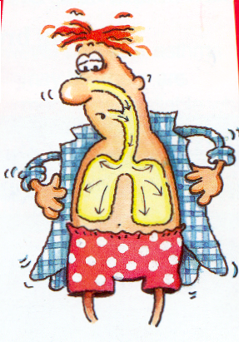
What is Asthma ?
Asthma is a condition that affects the airways - the small tubes that carry the air in and out of the lungs.
Children with asthma have airways that are almost always swollen and inflamed.

Slide 5


Triggers

Slide 6
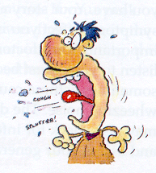
Asthma Symptoms
When the airways narrow asthma
When the airways narrow asthma symptoms can occur and include:
Coughing
Wheezing
Breathlessness
Chest tightness
Breathlessness
Chest tightness

Slide 7
What does Asthma Feel Like ?
“It feels like someone is standing on my lungs”.
“It feels like I am being squashed”.
“When I’m having an attack it feels like a rope is being slowly tightened around my chest”.

Slide 8
What Medications are used in the Treatment of Asthma ?
Preventers
Relievers

Slide 9
Preventers
Preventers help to prevent asthma attacks.
They protect the lining of the airways, calm down inflammation and stop the airways from being so sensitive.

Slide 10
Preventers reduce the risk of severe attacks.
Their protective effect builds up over a period of time so they need to be taken every day, usually morning and evening, even if the child is feeling well.
There are other medications used to prevent /control asthma

Slide 11
Relievers
Relievers quickly relax the muscles surrounding the narrowed airways, allowing the airways to open wider making it easier to breathe.
However, they do not reduce the swelling in the airways.

Slide 12
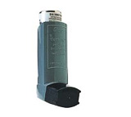
Relievers are essential in treating asthma attacks.
If taken before exercise they reduce the chance of asthma symptoms.
They come in blue containers.

Slide 13
Examples of Relievers
Salbutamol (Ventolin)
Works within 5 minutes to relieve asthma symptoms and last up to 3-4 hours.

Slide 14
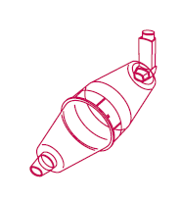
MDI – clearly labelled with name & class
Stored within the child’s classroom in a clearly visible & accessible place
Inhalers to be taken outside or to gym for PE & on all school trips

Slide 15


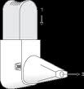

Different Inhalers

Slide 16
What is the Legal Position of School Staff?
Teachers & other school staff have no legal duty to give asthma medication
Giving or supervising a pupil taking it is a voluntary role
In an emergency situation school staff are required under common law, duty of care, to act like any reasonably prudent parent.

Slide 17
Top tips
Keep calm
Encourage child to sit up & slightly forward – do not hug/lie them down
Ensure tight clothing is loosened
Reassure the child

Slide 18
How to Recognise Worsening Asthma
If If the child has:
increased cough
increased wheeze
increased breathlessness
needing to use the Reliever (blue
inhaler) more than 4 hourly.
the

Slide 19
What to Do
Give 2 puffs of Reliever (blue inhaler).
Wait 5 minutes. If no improvement Repeat.
Wait for a further 5 minutes. If no improvement move to AMBER

Slide 20
Amber instructions
If child has symptoms in green section but has no improvement with recommended treatment action to take:
Give an additional 5 puffs of the Reliever (blue) inhaler via spacer device (volumatic)
Inform parents that child will need medical review.
If no improvement move to RED

Slide 21
Medical Alert/Emergency
If the child is:
breathing faster than usual using their tummy muscles and tracheal tug(neck dipping in)
having difficulty in speaking (due to their asthma symptoms)
Tired, pale or blue around the lips

Slide 22
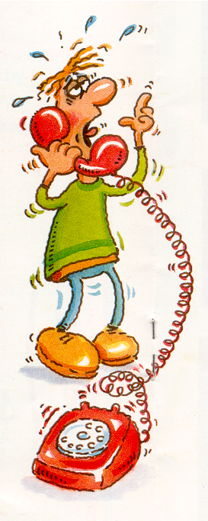
What to Do
      DIAL 999 – YOU MUST SEEK MEDICAL ADVICE
Give 1 puff of the Reliever (blue inhaler) every 30 seconds up to 10 puffs using a spacer device (volumatic) continue giving 1 puff every minute until help arrives.

Slide 23
Important guidance
Never leave a pupil having an asthma attack
If pupil does not have their inhaler and /or spacer with them, send another teacher/pupil to get the medication
Reliever medication is very safe. During an asthma attack do not worry about pupil overdosing.
Send another teacher/pupil if ambulance needs to be called

Slide 24
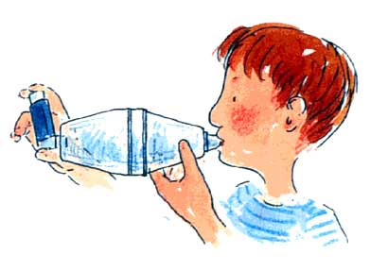
Emergency Inhalers in School Amendments to the Human Medicines Regulations 2012 to allow the supply of Salbutamol inhalers to schools.

Slide 25
New law for Emergency
Salbutamol inhaler in
School
The government laid before Parliament
On July 18th July 2014
Human Medicines (Amendment No 2)
These Regulations came into effect October 1st 2014
Head Teacher if they wish can purchase a Salbutamol MDI and Large Volume Spacer (Volumatic)
From any Pharmacist (telephone prior to request)
Request from Head Teacher on headed school paper

Slide 26
The Principles of a
School Asthma Policy
Welcome pupils with asthma
Understand asthma
Parental responsibility
Records of medication
Immediate access to reliever inhalers
Ensure full participation in all aspects of school life, i.e.
PE & school trips
Favourable school environment
Know what to do in the event of an asthma attack
Work in partnership

Slide 27
How Teachers can Help
Ensure all asthmatic children take their inhaler prior to sport/activities as necessary.
Ensure relievers are easily accessible for use by asthmatic children when needed.
Ensure correct treatment & instructions are supplied for school trips.
Be aware of asthma triggers within the classroom.
Inform parents of children using their reliever inhaler more often than usual.
Educate children with asthma & their peers.
Know what to do in an emergency.

Slide 28

THE END

