Slide 1














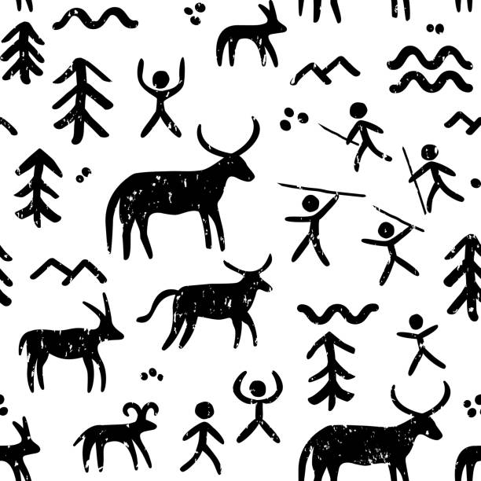
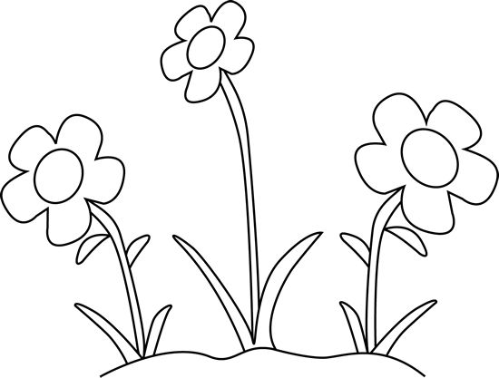

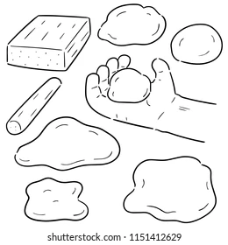

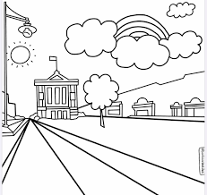


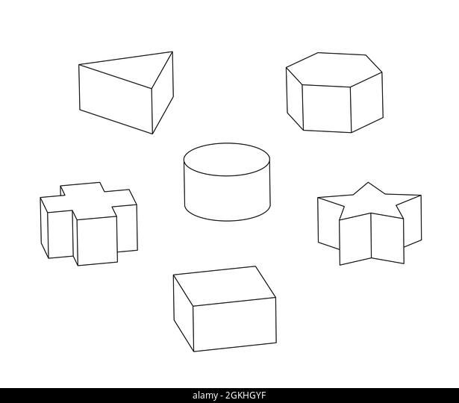




Our Art and
Design Journey
Making memories
Documenting their memories of their time at primary school, children select their favourite art and design skills and techniques to design and create a 3D artwork to represent these memories.
Make my voice heard
Exploring art with a message, children look at the famous ‘Guernica’ by Picasso and the confronting works of Käthe Kollwitz.
Secondary education
Artist Study
Identifying an artist that interests them, children research the life, techniques and artistic intentions of that individual.
YEAR
6
I need space
Developing ideas more independently, pupils consider the purpose of drawings as they investigate how imagery was used in the ‘Space race’ that began in the 1950s.
Architecture
Investigating the built environment through drawing and print making. Pupils will learn about architecture and create building designs.
YEAR
5
Portraits
Investigating self-portraits by a range of artists, children use photographs of themselves as a starting point for developing their own unique self-portraits in mixed-media.
Mega materials
Exploring the way different materials can be shaped and joined, learning about techniques used by artists.
Power prints
Using mechanical engravings as a starting point, pupils develop an awareness of proportion, composition and pattern.
YEAR
Light and dark
Developing colour mixing skills, using shades and tints to show form and create three dimensions when painting.
4
Prehistoric Painting
Investigating making their own paints, making tools and painting on different surfaces, the children explore prehistoric art.
Growing artists
Using botanical drawings and scientific plant studies as inspiration, pupils explore the techniques of artists such as Georgia O’Keefe and Maud Purdy.
YEAR
3
Abstract shape and space
Exploring how shapes and negative spaces can be represented by three dimensional forms. Manipulating a range of materials, children learn ways to join and create free standing.
Clay houses
Developing their ability to work with clay, children learn how to create simple thumb pots then explore the work of sculptor Rachel Whiteread.
Tell a story
Using storybook illustration as a stimulus, children develop their mark making skills to explore a wider range of tools and experiment with creating patterned surfaces to add texture and detail to drawings.
YEAR
2
Life in colour
Exploring primary and secondary colours. Discussion and the prediction of colour changes when two colours mix. Describing colours and textures in their work.
Make your mark
Developing observational drawing skills when explorating mark-making . Children use a range of tools, investigating how texture can be created in drawings.
Colour Splash
Exploring colour mixing through paint play, children use a range of tools and work on different surfaces.
Paper play
Creating simple three dimensional shapes and structures using familiar materials, children develop skills in manipulating paper and card.
YEAR
1
Paint my world
Creating child-led paintings using fingers and natural items as tools, children learn that colours can be mixed and that paintings can be abstract or figurative.
Our Learning Journey
C
EYFS
Let’s get crafty
Children will develop their cutting, threading, joining and folding skills through fun, creative craft projects.
Marvellous marks
Exploring mark making and using the language of texture, children use wax crayons to make rubbings and chalk on different surfaces.

