Slide 1





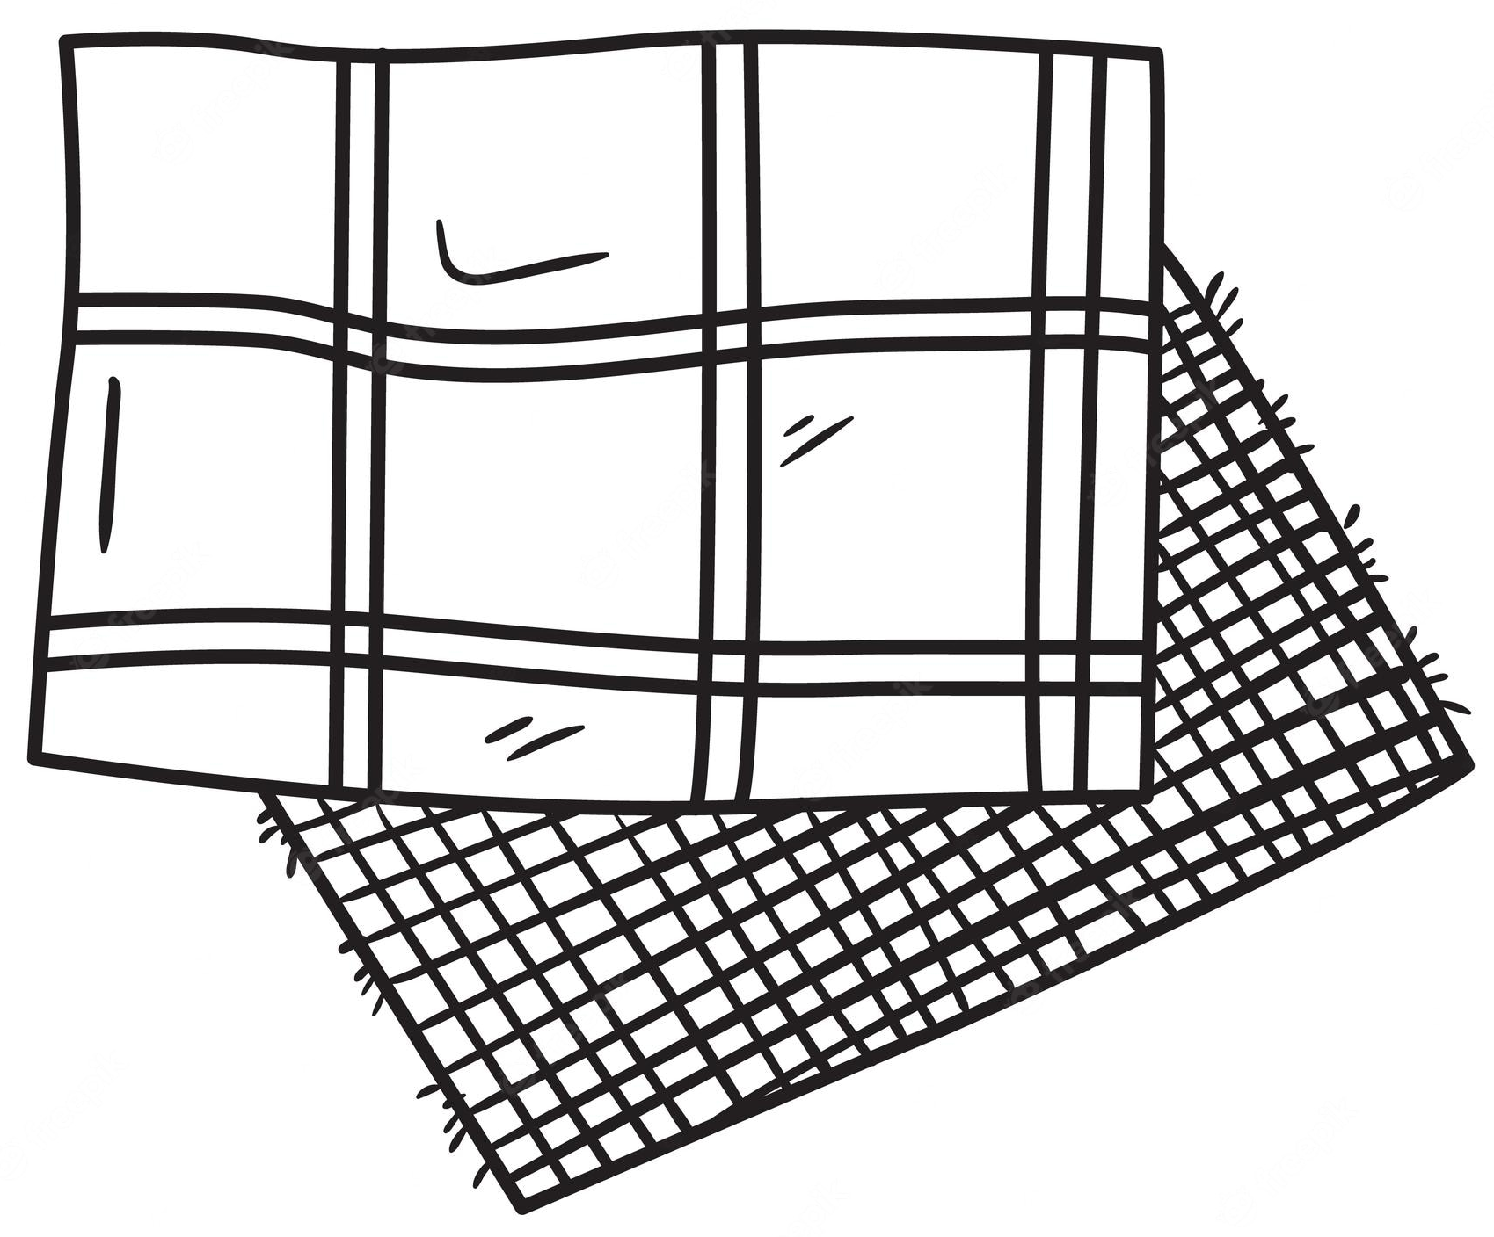


Our DT
Journey
Plan and create 3 structures, considering materials and construction type.
Use a template to mark and cut fabric. Running stitch. Waistcoat assembly.
To plan and cook a 3 course meal
Secondary education
YEAR
PLAYGROUNDS
WAISTCOATS
COME DINE WITH ME
6
Farm to fork. Making healthy choices. Adapting a recipe.
Design a toy. Blanket stitch. Appendages and assembly.
Using layers and spacers. Writing and illustrating.
YEAR
5
WHAT COULD BE HEALTHIER?
STUFFED TOYS
POP UP BOOKS
Exploring structure. Making pavilions and adding cladding.
Following a recipe. Testing ingredients and adapting a recipe.
Exploring and evaluating types of fastenings. Making a book sleeve.
YEAR
4
PAVILLIONS
ADAPTING A RECIPE
FASTENINGS
Exploring pneumatics. Design and make and decorate a toy.
International food supply. British seasonal food. Making a tart.
Design make and decorate a small cushion using applique and cross stitch.
YEAR
3
PNEUMATIC TOYS
EATING SEASONALLY
CROSS STITCH AND APPLIQUE
Running stitch. Using a template. Making pouches.
Exploring stability. Strengthening materials. Build and fix a chair.
Hidden sugars. Taste testing. Making a wrap.
YEAR
2
POUCHES
BABY BEAR’S CHAIR
BALANCED DIET
Categorising fruit and veg. Preparing and tasting ingredients. Making smoothies.
Joining fabrics. Design and make a puppet.
Exploring sliders, movement and paper construction.
YEAR
SMOOTHIES
PUPPETS
MOVING STORYBOOKS
1
Investigating floating and sinking. Making working boats.
Exploring threading, weaving a sewing.
Our Learning Journey
Fruit and veg. preparing food. Designing packaging.
C
EYFS
JUNK MODELLING BOATS
Build a solid foundation in education
Develop a lifelong love of learning
BOOKMARKS
SOUP

